Slide 1
Resume Building Website (TalentCrafters)
Student’s Name | Roll Number | Branch
Anmol Negi | 1/22/FET/BCS/131 | Btech CSE-N 4C1
Aayush Kukreja | 1/22/FET/BCS/159 | Btech CSE-N 4C1
Kartik | 1/22/FET/BCS/168 | Btech CSE-N 4C2
Under the Guidance of
Dr. Shobha Tyagi

Slide 2
Contents
Introduction
Problem Statement
Objective
What’s Done till now?
Proposed Methodology
Code Execution

Slide 3
01
Introduction
In the dynamic landscape of career development, a powerful and professionally crafted resume is your key to unlocking new opportunities. We are excited to present TalentCrafters, your go-to destination for simplifying the art of resume creation.
In today's competitive job market, standing out is more critical than ever. TalentCrafters is not just a platform; it's a tailored solution designed to empower you in shaping your professional narrative. We understand the nuances of a compelling resume and have crafted a user-friendly environment to guide you through the process seamlessly.
As we embark on this journey together, let's explore the key features and unique offerings that make TalentCrafters the ultimate companion in your career advancement.

Slide 4


Problem Statement
In the competitive job market, individuals often struggle with the time-consuming and challenging task of creating impactful resumes. Limited access to high-quality templates, concerns about data privacy, and the need for compatibility with applicant tracking systems present significant obstacles for job seekers.
Objective
Our project aims to streamline the resume-building process by developing a user-friendly platform that provides diverse, professionally designed templates. We prioritize user privacy, ensuring data security, and implement features for seamless compatibility with applicant tracking systems. The objective is to empower users to effortlessly craft personalized, industry-standard resumes, fostering a positive and effective approach to career advancement.

Slide 5

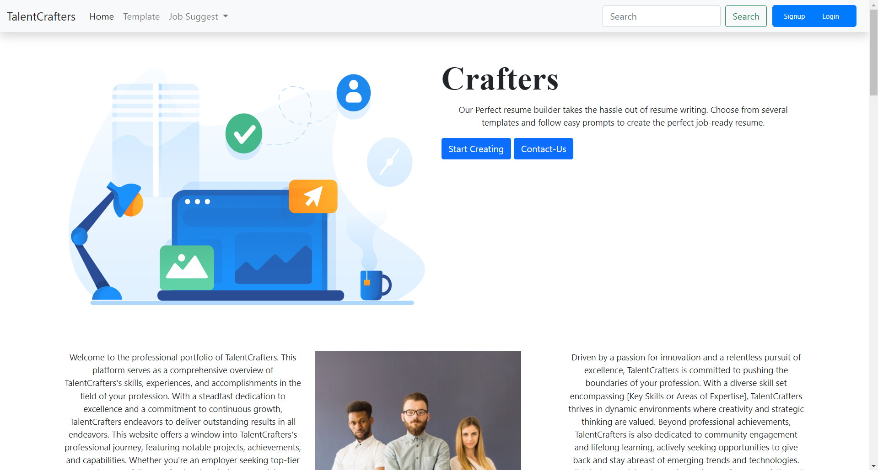
What’s Done till now?
Developed a resume-building website with the following core functionalities:
- User registration and login
- Profile creation and management
- Resume creation using user input
- Downloadable resumes in PDF format
Implemented additional pages for:
- Contact information
- Password recovery functionality

Slide 6

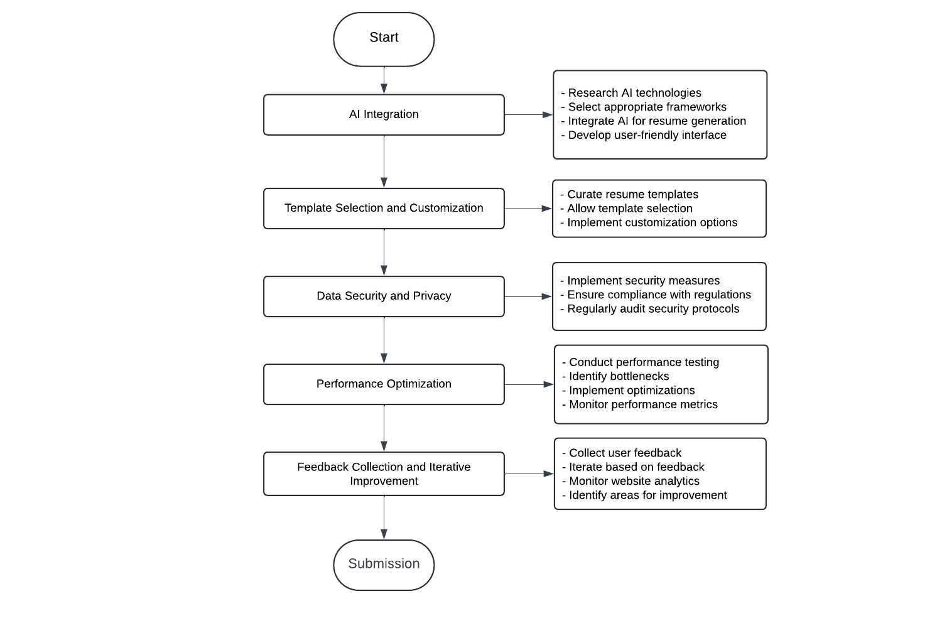
Proposed Methodology

Slide 7
AI Integration:
-Research and select appropriate AI technologies or frameworks for resume generation and template provision.
-Integrate AI functionalities into the website's backend to generate personalized resumes based on user input and preferences.
-Develop a user-friendly interface to allow users to interact with AI features seamlessly.
Template Selection and Customization:
-Curate a diverse range of resume templates to cater to different industries and preferences.
-Allow users to preview and select templates before generating their resumes.
-Implement customization options such as font styles, colors, and layout adjustments to personalize the chosen template.

Slide 8
Data Security and Privacy:
-Implement robust security measures to protect user data, including encryption techniques for sensitive information.
-Ensure compliance with data protection regulations such as GDPR or CCPA to safeguard user privacy.
-Regularly audit and update security protocols to mitigate potential vulnerabilities.
Performance Optimization:
-Conduct performance testing to identify bottlenecks and optimize website speed and responsiveness.
-Implement caching mechanisms, server optimizations, and content delivery network (CDN) integration to improve overall performance.
-Monitor website performance metrics and continuously optimize based on user traffic and usage patterns.

Slide 9
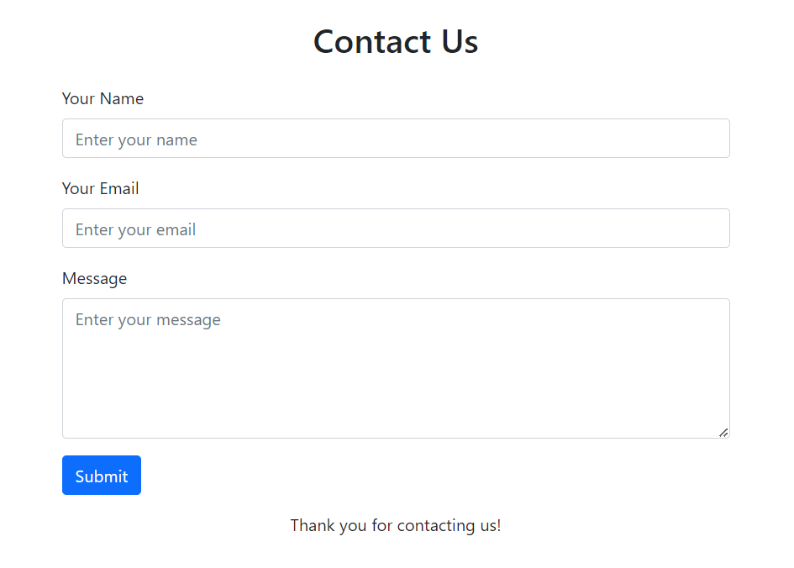
Feedback Collection and Iterative Improvement:
-Incorporate mechanisms for collecting user feedback on AI-generated resumes and template choices.
-Use feedback to iterate on AI algorithms, improve template offerings, and enhance overall user satisfaction.
-Continuously monitor website analytics and user engagement metrics to identify areas for further improvement.

Slide 10

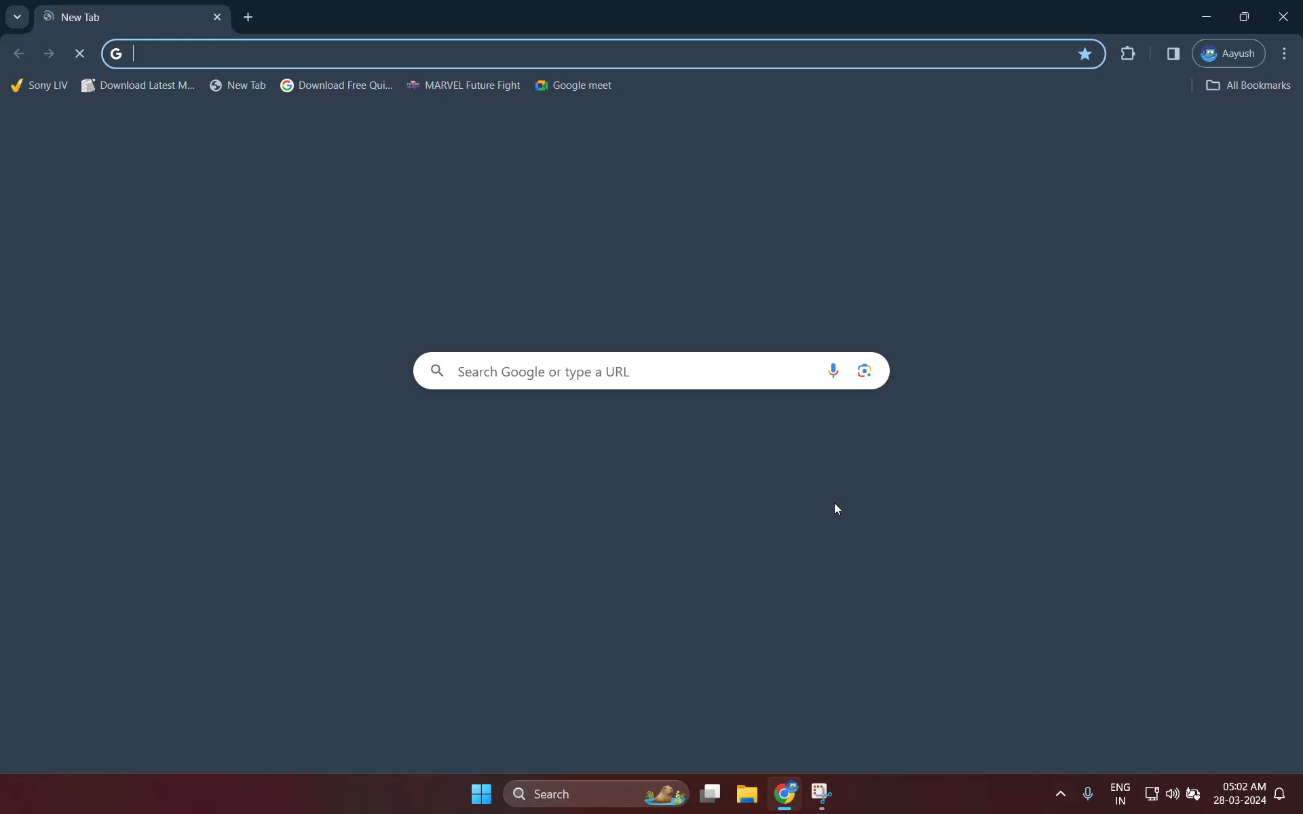
Code Execution

Slide 11
THANK YOU

